Slide 1
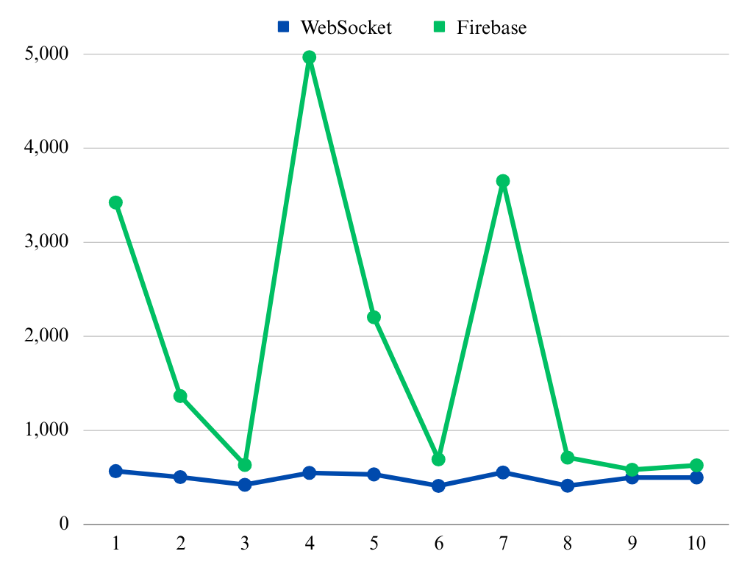
Delay in ms
Observation Number

